Slide 1
Scientific Writing in Medical Sciences;
Types of Medical Articles
Hadith Rastad, Ph.D
Epidemiologist
Assistant professor
Alborz University of Medical Sciences

Slide 2
Two Types of Studies
Primary Study
Secondary Study

Slide 3
Primary studies
Observational
Experimental

Slide 4
Secondary studies
Reviews (Overviews)
  Narrative reviews
  Systematic reviews & Meta-analyses
Guidelines
Decision analyses
Economic analyses

Slide 5
Types of Medical articles
Original Article
Review Article
Case Reports
Editorial
Short Communication (Briefs, short papers)
Letter to The Editor

Slide 6
Original articles
Will be discussed in specific sessions.
IMRAD
Notes:
One of the fundamental purposes of medical journals is to publish original research results in the form of journal articles.
However, journals publish many other types of informative and educational items.
In this chapter, we describe how to write other types of publishable documents

Slide 7
Review Articles
Review articles are very popular with readers and editors
Journal editors like reviews because:
  review is likely to be widely read
  highly cited
  increase the journal’s impact factor
Annotations: short reviews
Notes:
To maintain reader interest, review articles must be topical, up to date, accurate and authoritative ) əˈθɔːrəˌtetɪv(, and, if possible, provocative ) proˈvɑːkətɪv( and a good read ) something that you enjoy reading(.
Very short reviews are often called annotations.
قابل اطمینان- بحث روز--بحث انگیز- محرک

Slide 8
Titles for reviews should be:
Short
Catchy
humorous (if possible)

Slide 9
Example: Titles of reviews and annotations
The diagnosis of Prader–Willi syndrome
Suffocation, shaking, or sudden infant death: can we tell the difference?
Folate before pregnancy: are we doing enough?
Rett syndrome: clinical update and review of recent genetics advances
Beds, bedroom, bedding, and bugs: anything new between the sheets?
Similar, the same, or just not different: a guide for deciding whether treatments are clinically equivalent
Of mice, men, and microbes: hantavirus
Notes:
خفگی

Slide 10
Narrative Reviews
Narrative reviews are usually written to:
  address new developments
  summarize recent literature
Who should write a narrative review?
  Narrative reviews are an expert opinion that is an extension of current thinking and not a definitive evaluation of the literature
Notes:
ا روايتي یا مروری نقلی
تحقیقات اخیر در یک موضوع تحقیقی
مقاله مروری تحقیقات اخیر در یک موضوع تحقیقی را بگونه ای خلاصه و سازماندهی می کند که بتواند به دیگران در فهم و تجمیع آن موضوع کمک کند.

Slide 11
Narrative reviews have sometimes been criticized as “old fashioned”
Do not need to specify:
  Search strategy
  Inclusion and exclusion criteria of studies
  How the quality of citations was assessed.
  Bias
So, what’s the solution?

Slide 12
Sequential steps for writing a narrative review
Make decisions about novel ideas or new opinions
Decide on a literature search strategy
Collect all relevant literature
Enter citations into an electronic database
Form subheadings
Within subheadings, organize literature into subgroups that form topic sentences
Fill in the content

Slide 13
Constructing the review
Effective title
Clear introduction
  What the article is about
  Say why it is worth reading
Statement of how the data were selected
Presentation of the data
Clear conclusions

Slide 14
Case Report
Case reporting is the oldest and most basic form of communication in medicine.
                JAW Wildsmith24

Slide 15
What we need for case reporting?
Patient with a disease or unusual condition
Literature review to find if it is uncommon enough to report.

Slide 16
Topics that may be reported in case reports
Clinical conditions that have not been described before
Unusual and unreported presentations of known clinical conditions
Unexpected beneficial responses to a treatment
Previously unreported adverse reactions to a treatment
Errors in diagnosis as a result of use of incorrect tests or presentation with unusual symptoms
New uses of a diagnostic tool or use of novel diagnostic tools
Phenotypes associated with a newly found gene

Slide 17
Format for the case report
Title:
  Short
  Descriptive
  Eye catching
Introduction
  The first paragraph discusses why the cases is unusual.
  The report may begin simply with the case description.
Case description
  Present the relevant data, including medical history, physical findings, results of tests and procedures, and treatment received.

Slide 18
Format the case report (cont’)
Discussion
  Explain how and why decisions were made
  What lesson is to be learnt
  The aim should be to refine and define the message for the reader
References
  The case report is not intended to be a state-of-the-art literature review.
Acknowledgements
Notes:
Sometimes an illustrative case report may be
reported in the context of a literature review. However, because
the main purpose of most case reports is simply to describe the
patient and any relevant features, there is usually no need
for a literature review in either the introduction or discussion
sections.

Slide 19
Guidelines for a case report
The report should detail:
  What happened to the patient
  The time course of events
  Why the particular management was chosen
  An opening section may not be needed. Begin with the case description if possible
  Positive features should be accentuated and irrelevant details avoided
  A photograph or other illustration may be useful
  Confidentiality must be absolute
  The discussion should be useful and not overlong
  Reference other work only when necessary to make a specific point
  Cases that really merit publication always have an educational message

Slide 20
Case Report Size
The case report should not be too long
If your case report exceeds 12 double-spaced manuscript pages, consider cutting.
Most journals restrict the size of case reports:
  Gut restricts reports to 1500 words, 15 references, one table and two figures
  the Journal of Pediatric Gastroenterology restricts reports to 8 manuscript pages including any figures, tables, and references
  The New England Journal of Medicine publishes different types of case reports. One to three cases of a condition can be described in a brief report with a maximum of 2000 words, but clinical problem-solving reports are larger with a maximum of 2500 words and 20 references.

Slide 21
Case report vs. case series

Slide 22
Editorial
The best editorials are usually short, pithy, pertinent reviews about a topic that is selected by the editor.
An editorial is often commissioned to comment on a paper that is published in the same issue of the journal.
Very often, the editor asks an external reviewer to write this type of timely review.
Notes:
سرمقاله يا سخن ويژه: (Editorial) اين نوع مقاله، در مورد مقالات تحقيقاتي اصيل چاپ شده در مجله، يا مطلب يا موضوعی ویژه ، معمولاً وسیله سردبير يا هيأت تحريريه يا افراد مجرب و دست اندركار يك رشته خاص تهيه مي شود.
مختصر
مرتبط

Slide 23
Some Types of Editorial
Editorial Salesmanship
  Discuss why they chose to publish a lot about a specific topic and occupy the pages.
The Editor’s Opinion
  Writing about a new and important topic (hot topic)
Editorial Comment Regarding a Published Study
Sharing Special Insight
Notes:
1-پیشگفتار
4- فرد خارجی روی یک موضوعی که کانترورشیاله
Because medical research has been heavily supported by the
pharmaceutical industry, it is important that the opinions
expressed in editorials are independent of any types of
financial influence. Thus, it is important that editorial authors
do not have any financial ties to companies that manufacture
any products that are discussed6 and, to circumvent this,
editorial writers are often asked to make strict declarations of
any conflicts of interest.

Slide 24
Editorial
a rewarding way to disseminate your personal beliefs about a specific research
often more far reaching than a journal article because :
researchers are more likely to read it and you have the opportunity to extend thinking beyond simply interpreting the study results.

Slide 25
Fundamental types of editorial
Invited by the editor or publisher
  May be focused on a specific research study being published
Volunteered.

Slide 26
If you asked to write an editorial:
be sure that you have some new insights into the subject matter and that you can complete the task before the set deadline.
And If you do not have broad expertise in the research area, it is usually acceptable to enroll Coauthors…. result in more grounded and fully informed article
Notes:
Journals will
not want to delay the publication of a paper because the
editorial is not ready and for this reason usually ask authors to
sign a binding contract.
Writers often enrol coauthors with specific expert
experience. If as an epidemiologist you are asked to write an
editorial about the effects of breastfeeding, you will probably
want to enrol an expert in early infant feeding. If as an expert
in early infant feeding, you are asked to write an editorial
about a population study of breastfeeding, you will probably
want to enrol an epidemiologist.

Slide 27
Structure of an Editorial (1)
Present the problem
  Tell your reader the issue you are addressing in the first sentence of the first paragraph
Offer evidence to support your opinion.
  Select the references carefully, to avoid allowing your editorial to become a review article.
Offer personal insight
Offer counterevidence
  Present the other side of the issue in an unbiased and respectful manner, and then say why you are not convinced.

Slide 28
Writing an Editorial (2)
Provide a summary and conclusion.
  In single closing paragraph describe your conclusion
  Ideally relating to what you said in paragraph one.
  Perhaps include the implications of your conclusion to practice or to society.
Cite references
  Include a few
Include headings

Slide 29
Letters to Editor
Letters or communications are written for many reasons:
To provide supporting information,
Clarification,
Criticism,
Correction, or
An alternative explanation to the results in a previously published journal article

Slide 30
Letters
You may disagree with the interpretation of the results, have further information to add to a publication, or have a novel comment to make.
Notes:
Many journals also publish letters that convey political or psychosocial messages that are related to the practice of medicine or research.

Slide 31
Letters
If you decide to write a letter, it needs to carry a clear and succinct message
Only consider writing a letter if what you want to say justifies a communication.

Slide 32
Letters
Limit yourself to making a single point. Do not try to combine two or more ideas into a short letter.
Stick to the point

Slide 33
Letters
Before you begin writing, it is best to:
read the correspondence section of recent issues of the journal to get a feel for the type and style of letter that is published
Read the Instructions to authors

Slide 34
Letters
The Journal of the American Medical Association (JAMA), for example, states,
“Letters discussing a recent JAMA article should be received within 4 weeks of the article’s publication and should not exceed 400 words of text and 5 references.

Slide 35
Example of AJPH guideline:
Letters to the Editor referring to a recent AJPH article are encouraged up to 3 months after the appearance of a published paper…….Text is limited to 400 words and 10 references. A single table, figure, or image is permissible.
As of July 1, 2012, Letters to the Editor and Responses will be published online only, to improve timeliness and debate.

Slide 36
letters
Peer review??
How to write clear letters??
Length of letter ?? 500 words or two pages
The number of authors ?? four to six,
The number of references?? less than five
Notes:
As with other publications, letters are often treated much as original papers and sent out for external peer review. However, some journals publish non-reviewed letters that relate to matters raised in the journal in the previous six weeks.
A letter in response to previously published work may be sent to the authors of the work, and your letter plus the authors’ responses are then published together.
Read rapid responses ?????????
Although letters are short, they often take a surprising amount of time to write, hone, and perfect. Even so, the editorial committee may edit and shorten your letter even further. However, do not rely on this. If your letter is too long, it may not be considered for publication at all and your message will not reach your audience. In most journals, letters have to conform to a word limit. For example, 500 words or two pages is usually the maximum and this may include a figure or a table.
The number of authors is also usually limited to a maximum of four to six,
and the number of references is usually limited to less than five including a reference to the journal article to which the letter relates.

Slide 37
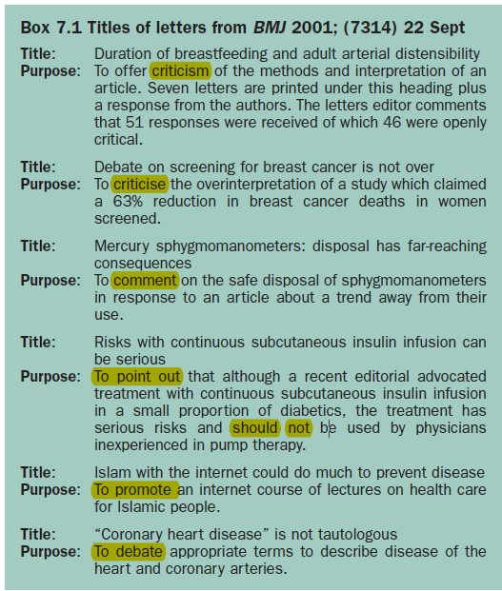
Notes:
The topics are extremely varied and include comments on previous publications and news items,
warnings about the safe disposal of old equipment, and the applicability of new treatment methods.
The letters also include an educational note about a new website that is relevant to the health of over one billion people worldwide,
and
a comment on whether the term “coronary heart disease” is a tautology.

Slide 38
Letters
If you feel the need to criticize the work of others in print, you must put forward a reasoned argument rather than make general comments….. introduce a new and different perspective
Always be polite and constructive rather than arrogant and critical.
Rather than writing Smith et al. were clearly wrong in their interpretation of their data, it is better to couch this sentiment in a phrase such as There may be another interpretation of the data presented by Smith et al.
Notes:
Most letters are written to offer criticism of a previous publication, although some offer support.
Remember, if your letter is published, it will remain in print a long time after your emotions have subsided.
Above all
else, whether you are criticising or supporting the previous work of other researchers, you must introduce a new and
different perspective on the work if you want your letter to be printed.

Slide 39
Structure Of The Letter To The Editor
Identify the paper.
  In the first sentence, cite the paper that is the subject of your comments. This becomes your Reference 1.
State why you are writing.
  State your agreement, disagreement, concern, or other reason for writing.
Give evidence.
  The evidence may be from the literature or from personal experience. Literature-based evidence is better.
Provide a summary statement
  Conclude by tying all the above together.
Cite references.
  Often a letter to the editor will have a few reference citations, but not too many.
Notes:
As with other publications, letters are often treated much as original papers and sent out for external peer review.
However, some journals publish non-reviewed letters that relate to matters raised in the journal in the previous six weeks.
A letter in response to previously published work may be sent to the authors of the work, and your letter plus the authors’
responses are then published together.

Slide 40
Short report as a letter (briefs)
Presentation of a study as a letter is rather similar to writing an extended abstract.
Three clear divisions
  Introduction and objectives of the study
  A section stating the methods, analysis, and results
  Conclusion.
An abstract is unnecessary.

Slide 41
Presentation of a concise report as a letter
Introduce the topic
  Briefly explain rationale and objectives of study
Present methods and results
  Reference methods as much as possible
  Include only essential data
  If possible present data in a table and/or figure
Present conclusions
  Emphasize only one or a few major conclusions
  Avoid extrapolating too far from data
  Highlight caveats and strengths of the study
Avoid repetition of data
Be concise

Slide 42
Example of AJPH guideline:
Briefs:
Preliminary or novel findings may be reported as briefs (up to 800 words in the main text, an unstructured abstract of up to 80 words, and up to 2 tables/figures). The main text of briefs must follow the standard AJPH research and practice format, with an introduction and separate sections for the Methods, Results, and Discussion.

Slide 43
Critical Appraisal tools

Slide 44
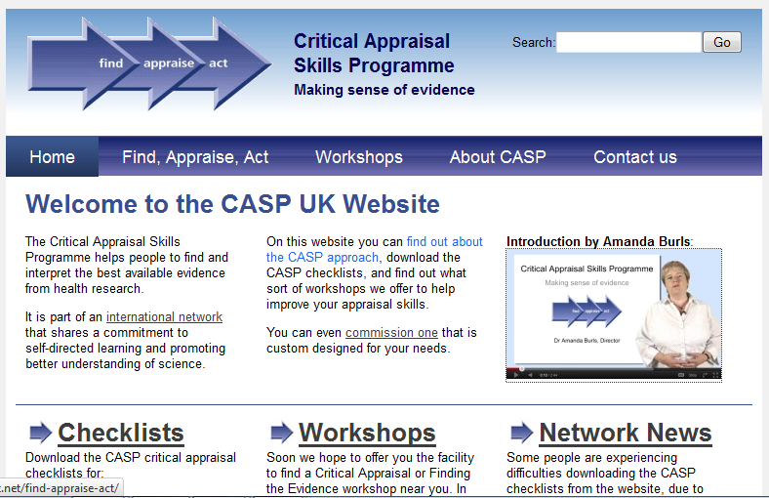
http://www.casp-uk.net/

Slide 45
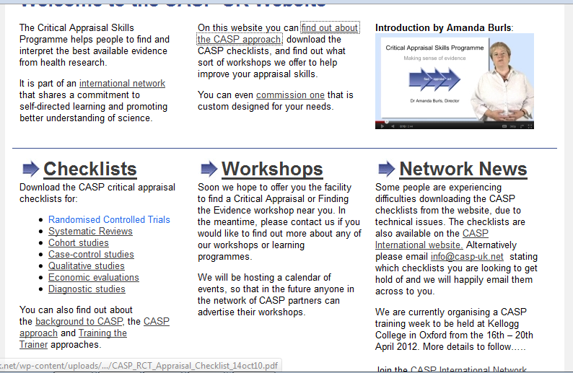

Slide 46
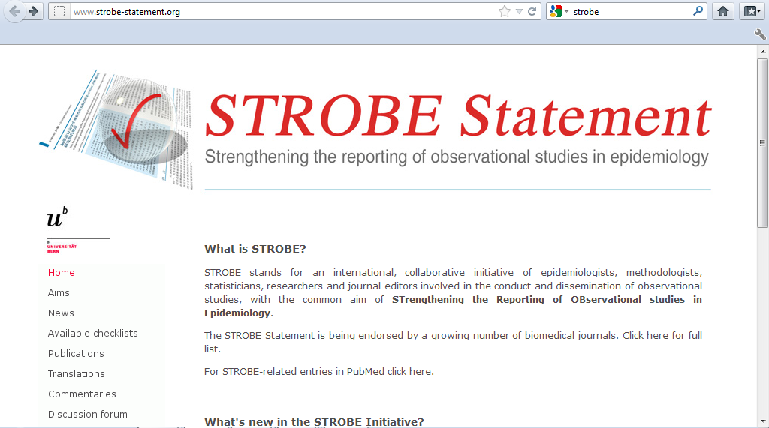
http://www.strobe-statement.org/

Slide 47
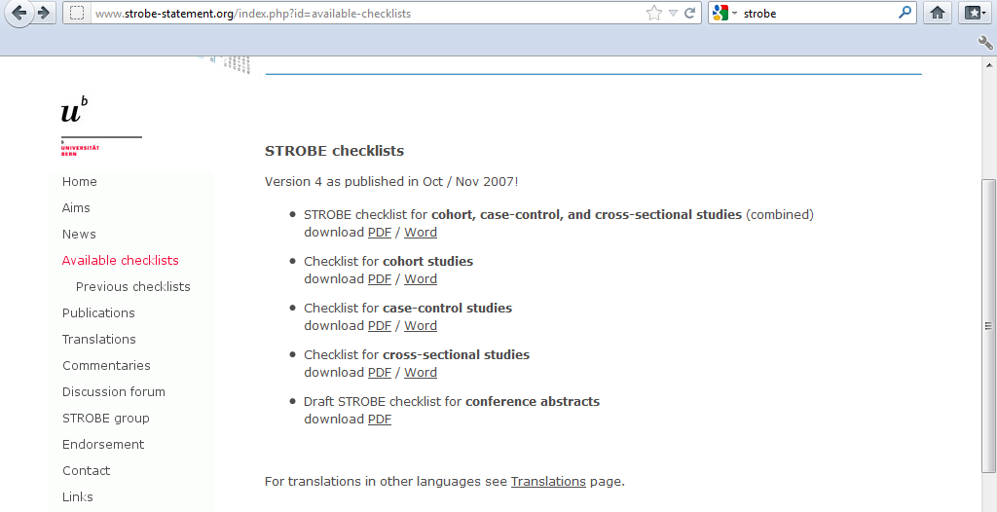
http://www.strobe-statement.org/index.php?id=available-checklists

Slide 48
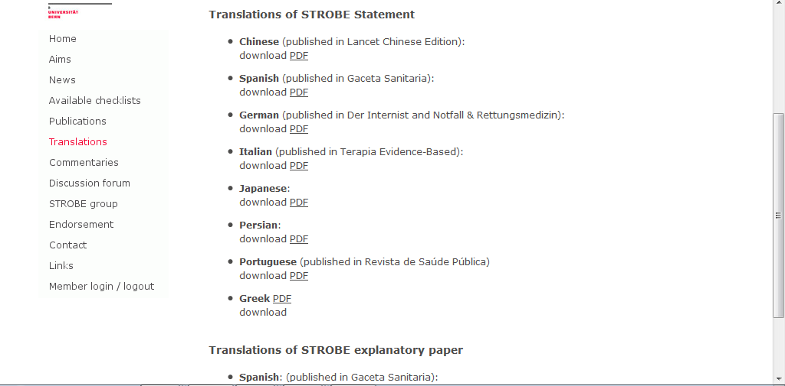

Slide 49
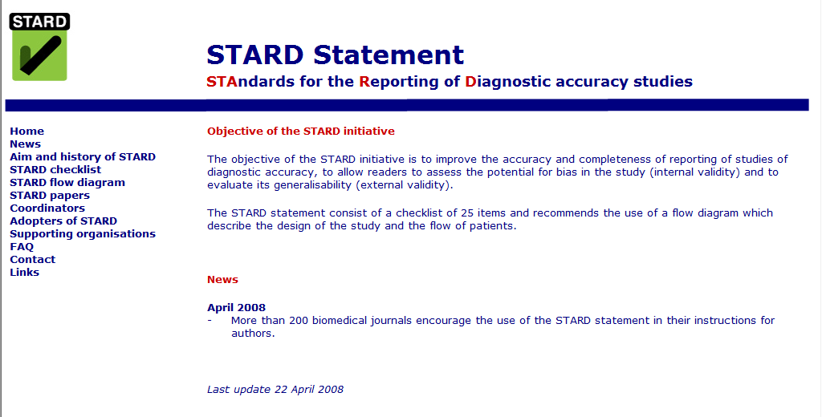
http://stard-statement.org/

Slide 50
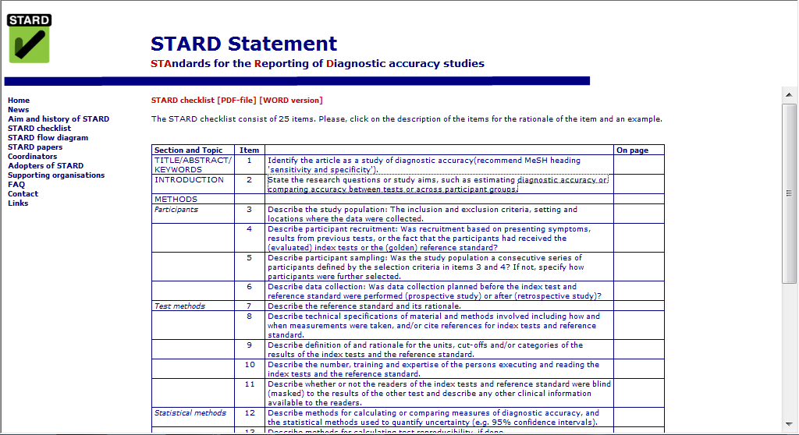

Slide 51
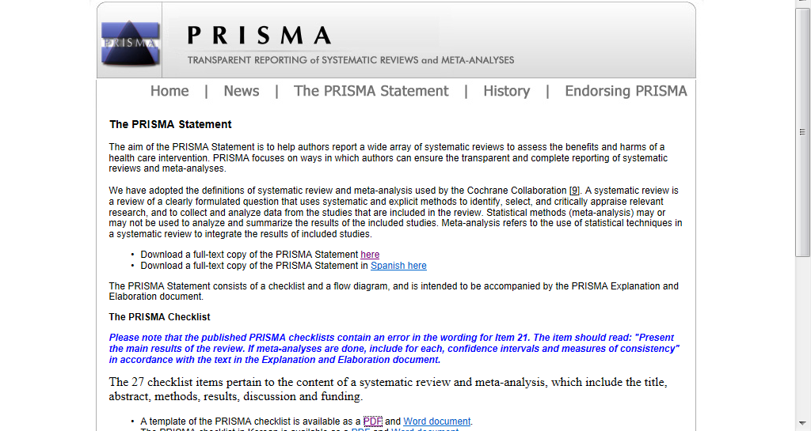
http://prisma-statement.org/statement.htm
Preferred Reporting Items for Systematic Reviews and Meta-Analyses.

Slide 52
Further reading
Hall GM, ed. How to write a paper. London: BMJ Publishing Group.
Scientific Writing Easy when you know how. Peat J. BMJ Publishing Group. 2002.
The Clinician’s Guide To MEDICAL WRITING. Taylor R. Springer

Slide 53

Questions

Slide 54
to: h.rastad91@gmail.com cc: kyazdani48@yahoo.com
تكليف: وب سايت EQUATOR network را بررسي بفرماييد. در حداكثر يك صفحه‌ي فارسي توضيح دهيد كه چيست و چه استفاده‌هاي مهمي دارد؟

Slide 55
Economic analysis:
A systematic approach to determining the optimum use of scarce resources, involving comparison of two or more alternatives in achieving a specific objective under the given assumptions and constraints.
Economic analysis takes into account the opportunity costs of resources employed and attempts to measure in monetary terms the private and social costs and benefits of a project to the community or economy.

